Slide 1
CROWD FUNDING USING BLOCKCHAIN
ATHIRA V
CUAWMCS009

Slide 2
Presentation outline
Introduction
Existing system
Proposed system
Modules
Technology platform
Application snapshots
Scope of future enhancement
Conclusion
Reference

Slide 3

INTRODUCTION
Blockchain technology offers a clear advantage for the crowdfunding industry, bringing transparency and security to the space and protecting both creators and donors in these interactions. Many traditional industries are moving their operations onto the blockchain to leverage the potential of this technology. It is only a matter of time before the crowdfunding industry explores the blockchain, opening the path for more funds to flow into the space Blockchain is a promising technology for charities as they look to promote transparency and at the same time cut the risk of fraud. But too often it is being ignored by charities through a lack of understanding, which can be due to a lack of technical expertise, as well as difficulty in explaining how it can offer charities tangible benefits.

Slide 4

EXISTING SYSTEM
There is not have been a widely recognized or prominent platform that exactly matches the detailed combination of this features – a blockchain-powered charity funding platform with voting, transparent tracking, and accountability measures. However, the technology landscape is constantly evolving, and new platforms and projects are developed all the time. It's possible that developments in the blockchain and crowdfunding spaces since then have led to the creation of platforms that share similarities with your concept

Slide 5

PROPOSED SYSTEM
The proposed system provides a comprehensive solution for transparent charity funding using both traditional methods and blockchain technology. It ensures user authentication, secure donation transactions, complaint management, and user management while incorporating the benefits of blockchain for transparency and security. Implementation details, technology stack, and specific smart contract design would need to be further developed based on the requirements and resources available.

Slide 6
MODULES
ADMIN
Login
Change password
View user
View Publicity added charity news accept and reject
Add donation request
View donation request
View user donation
View complaint and send reply
View organization
View status at each donation title

Slide 7
ORGANIZATION
Sign
Login
Change password
View profile
Edit profile
Add charity related fund raising request and forward in to admin for approval
View approved charity funds request
View current status charity request

Slide 8
USER
Registration
Login
Change password
View profile
Edit profile
View donation request
Add donation(block chain)
View donation status
View previous donation
Send complaint and view reply

Slide 9
PUBLIC
Forward charity related news to admin
View current status of all donation

Slide 10
TECHNOLOGY PLATFORM
Operating System : Windows 8 or above
Front end : HTML
BOOSTRAP
Back End : MySQL
IDE : Pycharm
FRAMEWORK : DJANGO
WEB BROWSER : Chrome

Slide 11
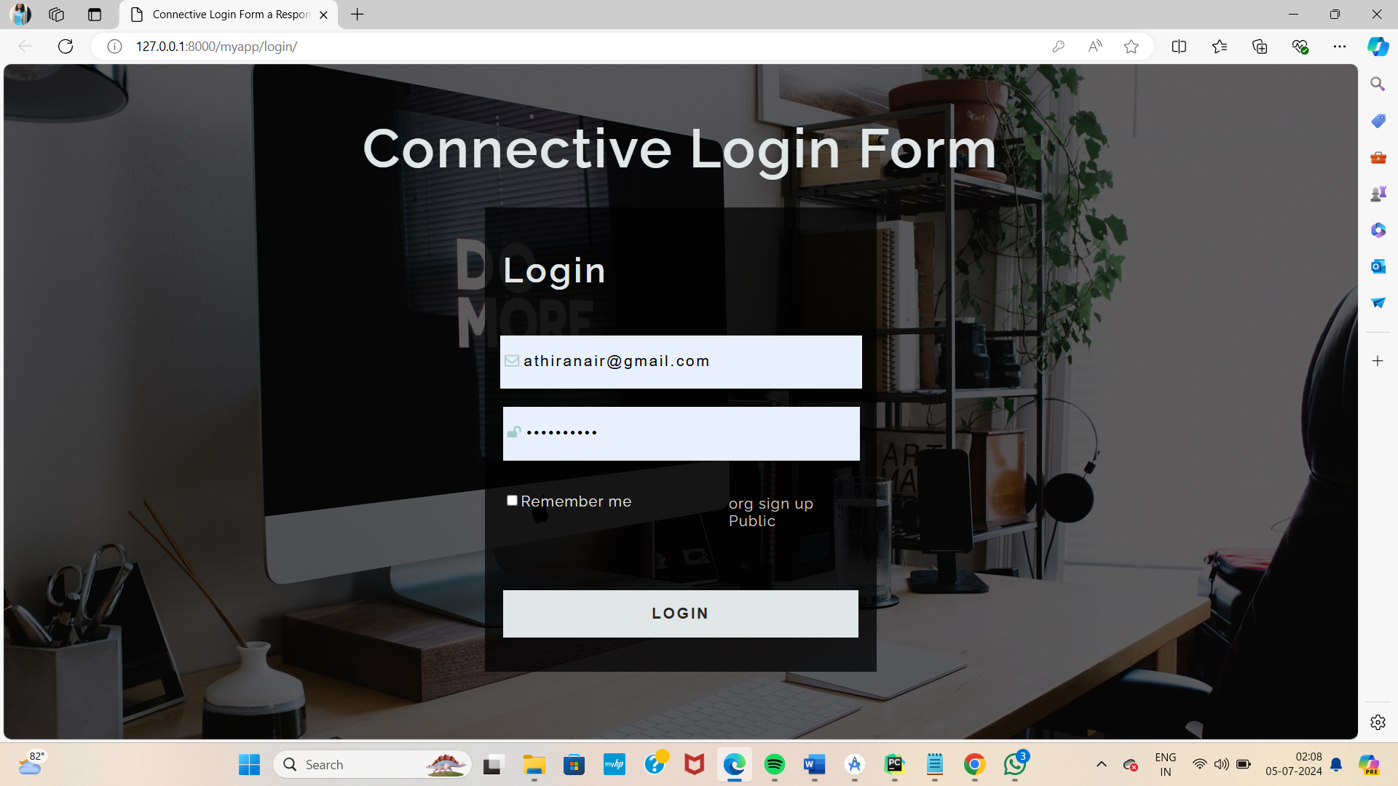
APPLICATION SNAPSHOT
Login
Admin login to the system using predefind username and password
System verify the account

Slide 12
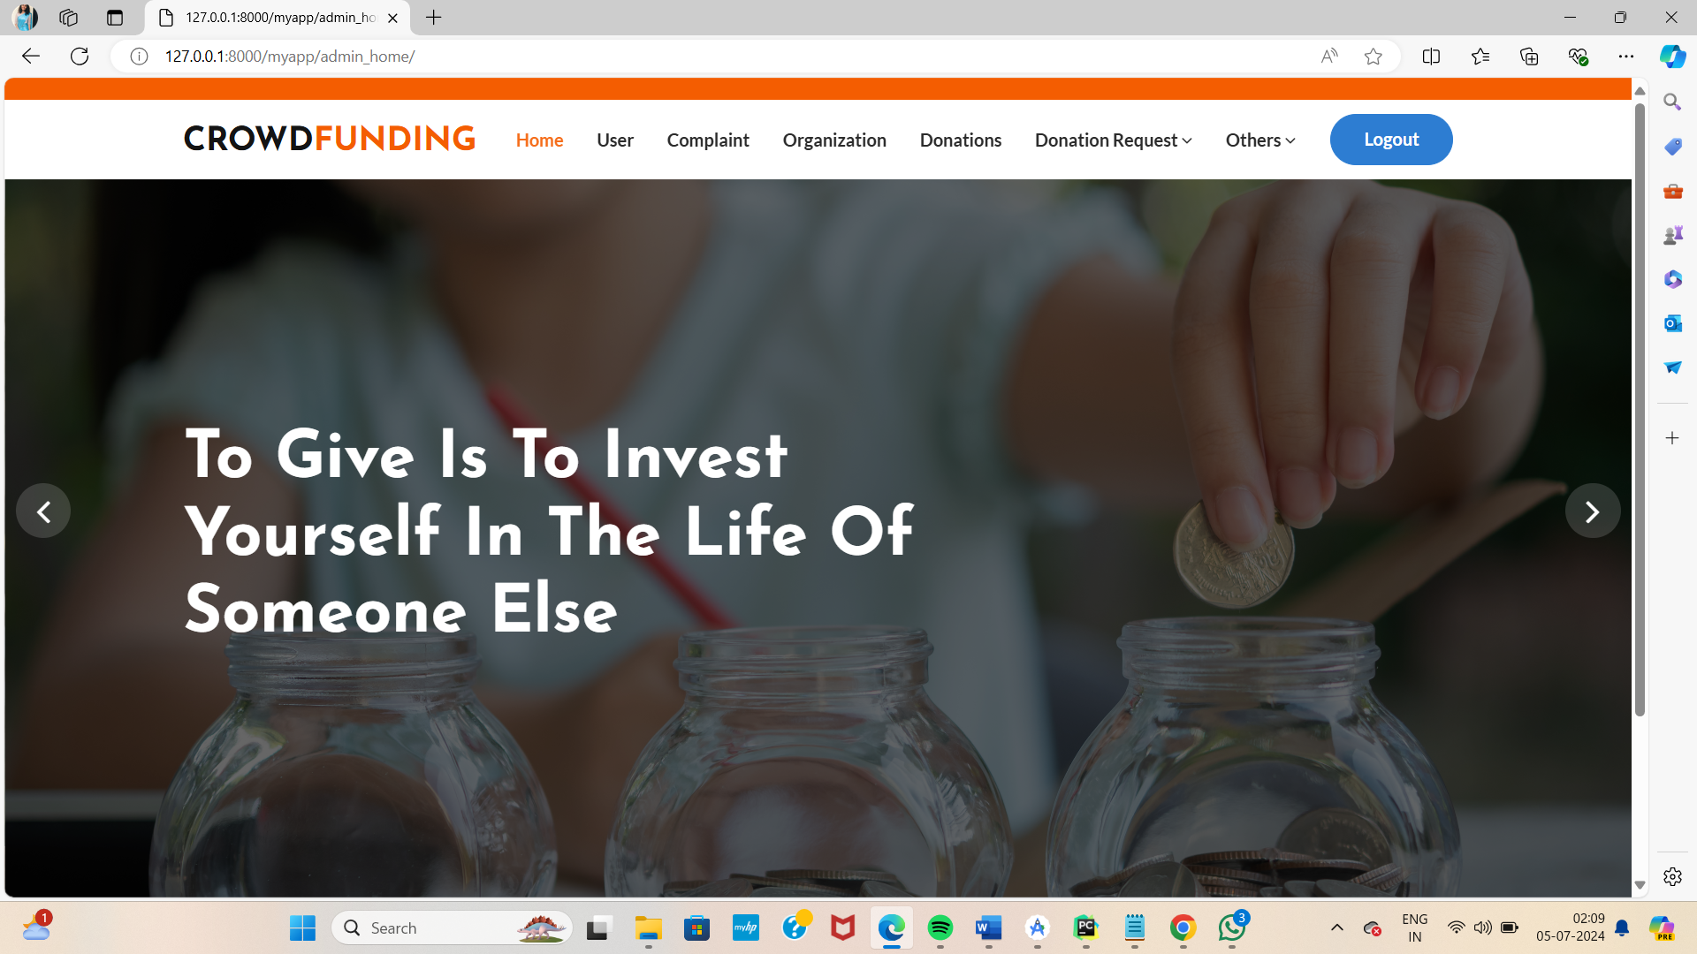
Admin home page

Slide 13
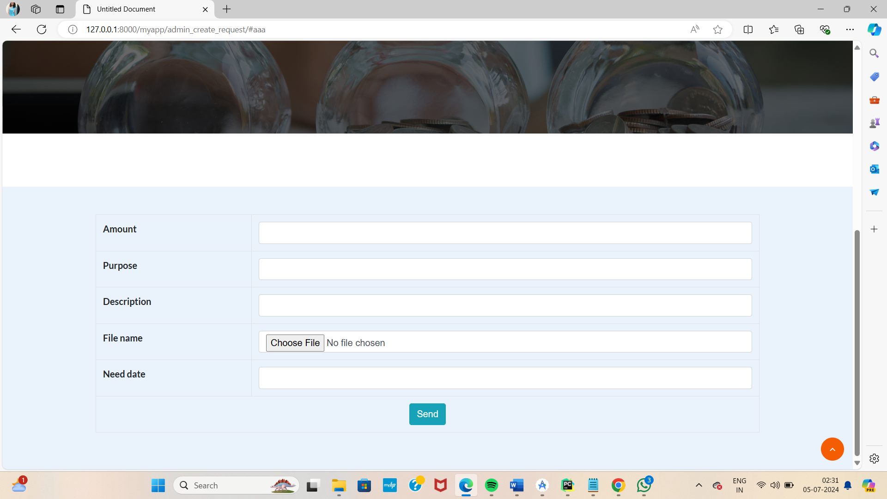

Slide 14
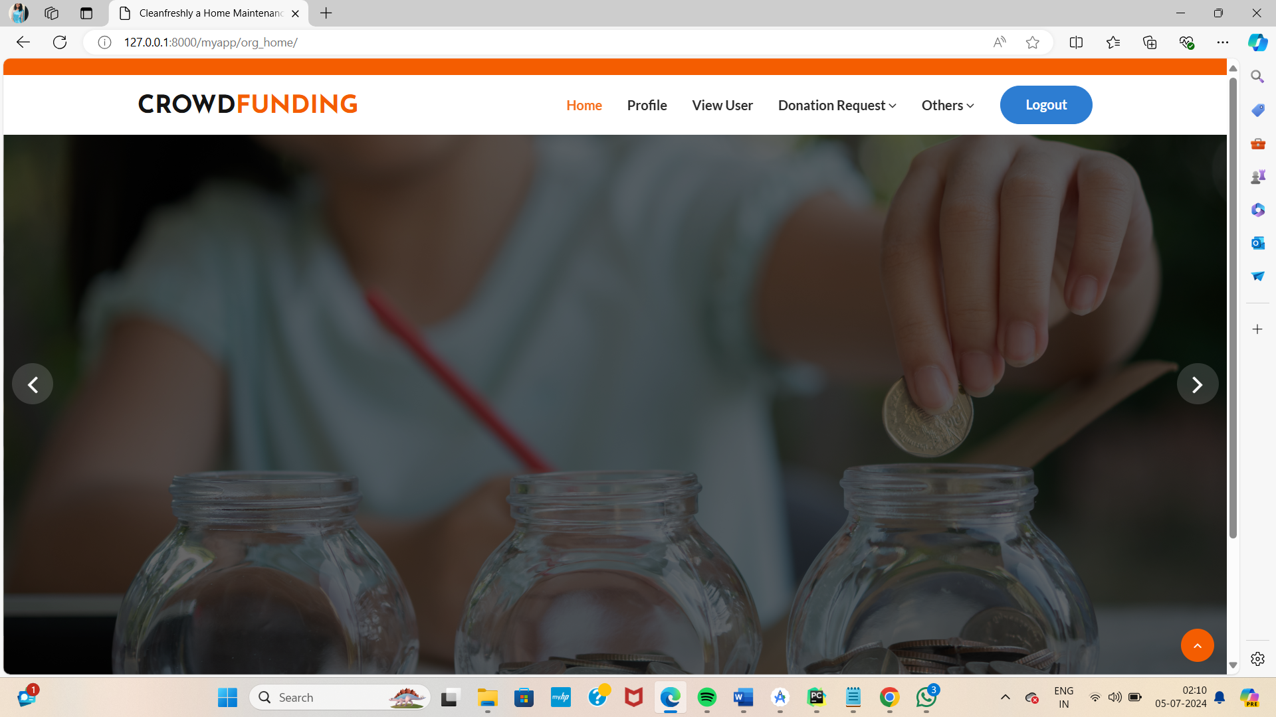
Organization home page

Slide 15
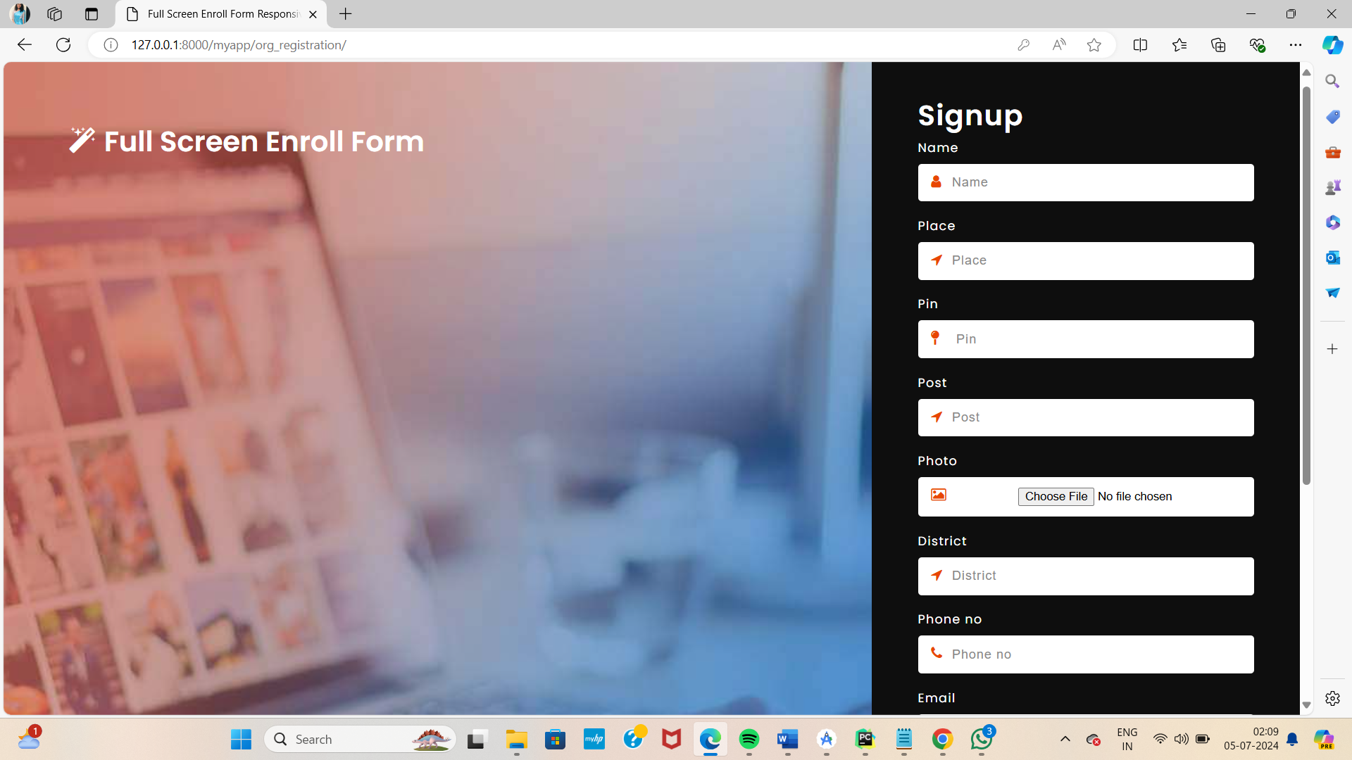
Organization registration

Slide 16
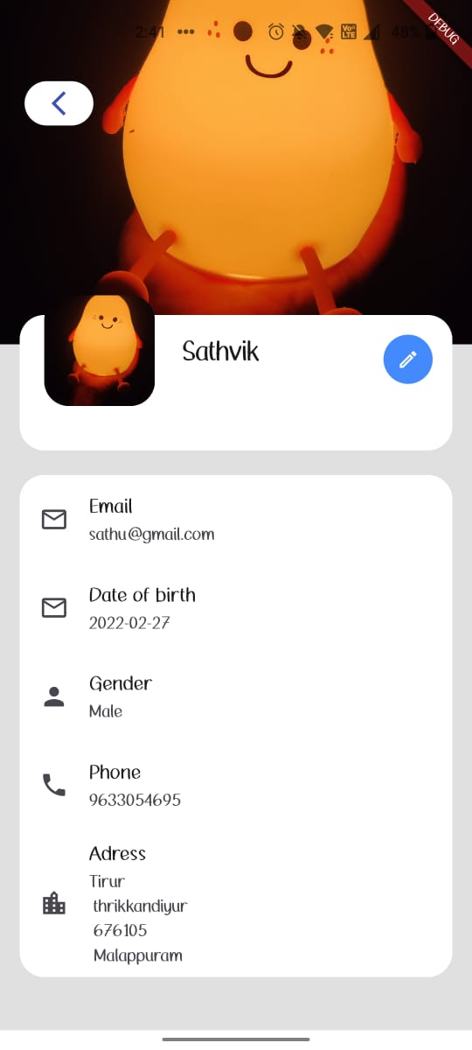
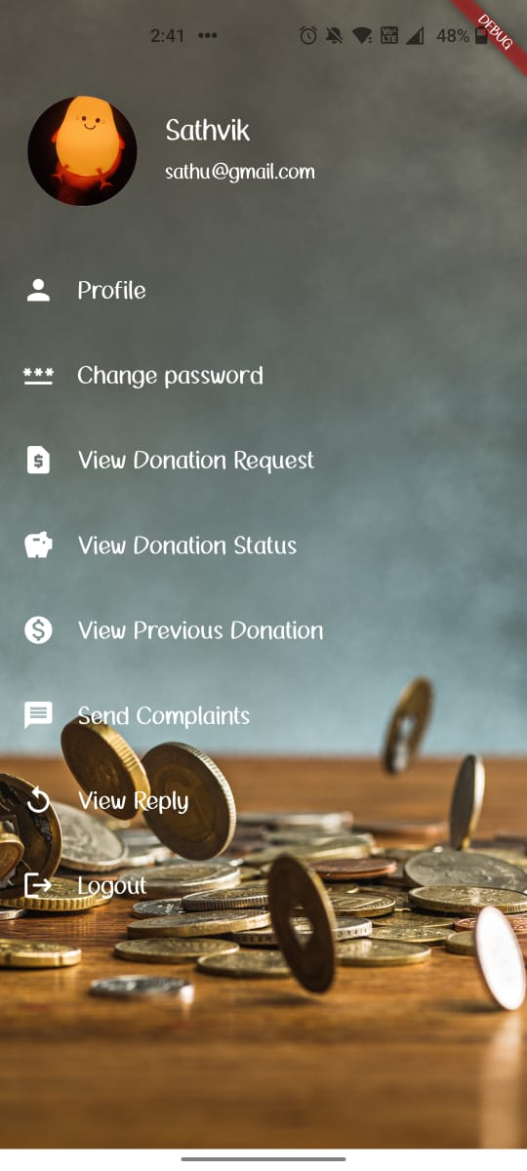
User home Profile

Slide 17
SCOPE FOR FUTURE ENHANCEMENT
The scope for future enhancements of crowd funding using blockchain is vast and promising, aiming to further refine user experience and expand the platform’s capabilities. Here are several potential areas for future development: The future enhancements could be as follows:
❖ Scalability: Improving blockchain scalability to handle a larger volume of transactions efficiently, thereby accommodating widespread adoption without congestion or delays.
❖ Interoperability: Enhancing interoperability between different blockchain platforms and cryptocurrencies to facilitate seamless cross-platform donations and transactions.
Enhanced Smart Contracts: Developing more sophisticated smart contracts that can automate complex conditions and disburse funds based on verifiable milestones or achievements, increasing trust and accountability.
❖ Tokenization: Exploring tokenization of assets to represent ownership or rights within crowdfunding campaigns, enabling fractional ownership and diverse investment opportunities.
❖ Governance and Transparency: Implementing decentralized governance mechanisms where stakeholders can participate in decision-making processes and transparently audit fund utilization through immutable blockchain records.
❖ Integration with IoT and AI: Leveraging Internet of Things (IoT) devices and Artificial Intelligence (AI) to track project milestones in real-time and provide predictive analytics on campaign success and impact.
❖ Enhanced Security Measures: Continuously improving security protocols to protect against evolving cyber threats and ensure donor data privacy.
❖ Community Engagement: Facilitating community engagement through blockchain-based voting mechanisms, allowing stakeholders to prioritize and fund projects democratically.
❖ Global Accessibility: Expanding access to blockchain-based crowdfunding platforms in underserved regions, empowering diverse communities to participate in global philanthropic efforts. In essence, future enhancements in blockchain-based crowdfunding aim to foster greater efficiency, transparency, and inclusivity in fundraising while addressing technological, regulatory, and societal challenges to realize its full potential.

Slide 18
CONCLUSION
Crowdfunding using blockchain technology represents a transformative approach to fundraising, offering unprecedented levels of transparency, security, and accessibility. By leveraging blockchain's decentralized ledger, crowdfunding platforms can eliminate intermediaries, reduce transaction costs, and enhance trust among participants One of the key advantages of blockchain in crowdfunding is transparency. Every transaction and donation is recorded on the blockchain, visible to all participants in real time. This transparency builds trust, as donors can verify where their contributions are allocated and ensure they align with the stated goals of the crowdfunding campaign. Moreover, smart contracts can automate the release of funds when predefined conditions are met, reducing the risk of fraud or mismanagement. Security is another critical benefit. Blockchain's cryptographic features protect transaction data from tampering, ensuring that funds are securely transferred and stored. This reduces the risk of hacks or unauthorized access, which is particularly crucial in online fundraising where data breaches can undermine donor confidence. User acceptance testing comprises a completed and successful end-to-end system test with review of the results by one or more users with specific knowledge. Blockchain also enhances accessibility by enabling global participation without geographical restrictions or reliance on traditional banking infrastructure. Anyone with internet access can contribute to crowdfunding campaigns, empowering individuals and communities worldwide to support causes they believe in. In conclusion, blockchain-based crowdfunding revolutionizes fundraising by promoting transparency, enhancing security, and broadening access. As this technology continues to evolve, its potential to reshape how charitable donations are collected, managed, and distributed holds promise for a more inclusive and accountable approach to philanthropy.

Slide 19
THANK YOU

